Slide 1
ENERGY CONSUMPTION
ANALYSIS

Slide 2
Introduction
The overarching goal is to understand the driving factors behind energy consumption in the counties of South Carolina and North Carolina through July. This involves through EDA and modeling to discover impactful explanatory factors. This approach helps simulate energy consumption and future requirements and seeks to mitigate the need for additional energy production facilities and contribute to a cost-effective and preventative approach to energy saving.

Slide 3
Research Question
“What is the relationship between economic status and household energy consumption within the state, and how can energy efficiency and weatherization be altered to reduce energy consumption and address energy inequity. This study aims to examine patterns of energy usage across income levels, and propose energy saving strategies to enhance energy sustainability across economically diverse communities”

Slide 4
Overview
This project mainly focused on the impact of energy consumption with an increase in temperature and how it varies with variables of interest.
Data Cleaning and EDA
Feature Engineering and modeling
Prediction and impact analysis

Slide 5
Data Cleaning and EDA
Initially, the datasets were obtained from the United States Government.
Subsequently, we initiated the process of extracting the requisite data from each of these datasets, namely the
Static House,
Energy Usage, and
Weather Data.
From each dataset, a select set of parameters deemed pertinent for our analysis were utilized.
The static house dataset was utilized to identify attributes or parameters pertinent to determining energy consumption, including building size (in square feet) and occupants' income.
We omitted all singular-valued columns due to the dataset's extensive nature, encompassing over 170 columns. Given the specificity of our research inquiries pertaining to income levels, we selected columns such as square footage and insulation attributes of residences.

Slide 6
In the Energy Usage dataset, we discerned four columns presumed to wield significant influence on energy consumption, subsequently categorizing them into hot and cold climate classifications.
The hot-humid climate zone is anticipated to exhibit heightened energy consumption due to prevailing weather conditions and prolonged daylight hours during this period.
Moreover, a primary objective entails forecasting energy consumption during the summer, factoring in an expected increase of 5 degrees Celsius in temperature. Consequently, our selection of the hot-humid climate designation aligns with this objective.
Regarding the Weather dataset, consideration is being given to developing models utilizing selected columns from the energy usage dataset to ascertain their relevance.

Slide 7
Data Preparation
Initially we planned to move with top 3 counties based on the diversified income but as we are considering the hot humid climate, we have filtered two counties for our study and using that we got a lot of buildings, so we merged the energy usage of all those buildings in one data frame based on the parameters we discussed above.
But we will change the factors from the size to income levels to understand the disproportionate energy demand better. Afterwards, the merged data frame will be used to combine it with the weather data of both the counties.

Slide 8
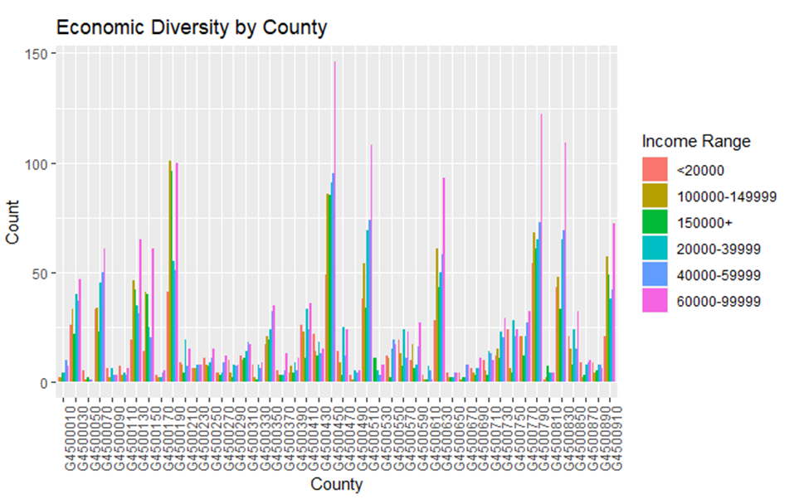
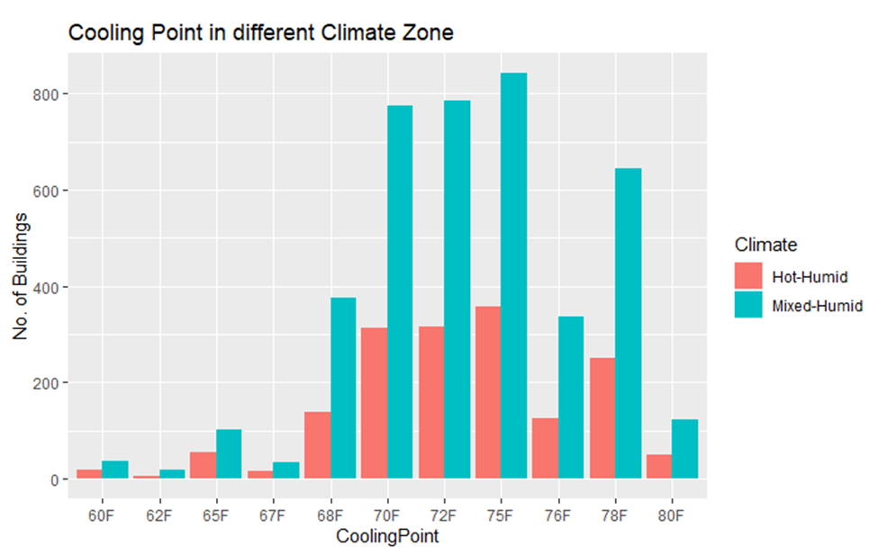
Climate zone and Economic Diversity in South Carolina
Notes:
We created a bar chart between cooling point and no. of buildings in both climates. Hot-Humid climate zone will have a higher energy consumption because of the weather and the days are longer during that period of time. Also, one of our goals is to predict the energy consumption during the summer where its given that it will be 5 degrees warmer. That’s why we decided to go with Hot-Humid climate.

Slide 9
Models Used & Output
Linear Regression Summary
In our project, the linear regression model is applied to predict energy consumption (heating and cooling) based on independent variables such as climate zone, income level, and building size.
The model estimates the coefficients of the linear equation that best fits the relationship between the independent and dependent variables, allowing for predictions of energy consumption for new data points.
Heating Model:- 94.5% , RMSE Value: 0.08, R-squared value: 0.945
Cooling Model:- 98.8% ,
RMSE value: 0.04,
R-squared: 0.988
Along with this, we did some cross-validation to conclude that the model would be overfitting on adding any more features and moved to a different approach.

Slide 10
Decision Tree using rpart package Summary
The decision rpart algorithm mitigates overfitting through built-in regularization techniques.
It selects the best attribute to split the data based on criteria like information gain and creating decision paths represented by branches. Performance is evaluated using accuracy, RMSE, and R-squared values, akin to linear regression.
Accuracy reflects the percentage of correctly classified instances, RMSE measures average deviation between predicted and observed values, and a higher R-squared value signifies better model explanatory power.
Decision model with rpart package
Heating Model : 92.4%,
RMSE Value: 0.09,
R-squared value: 0.92
Cooling Model: 95.44%,
RMSE value: 0.08,
R-squared: 0.954
Notes:
- Less sensitive to outliers - with the presence of airbases, airports and such buildings in the data - we had to be keep this in mind while choosing the model- It is a predictive model rather than an inferential model - more useful to make predictions - considering the demands of this project.- XGBoost provides feature importance scores, allowing you to understand which variables have the most significant impact on the prediction. This can help you identify key drivers of Final Energy Consumption.

Slide 11
Decision Tree using tree package Summary
It helps mitigate the problem of overfitting - because of its inbuilt regularization techniques.
The tree package provides an alternative implementation of the decision tree algorithm, which may incorporate differences in splitting criteria, pruning techniques, or other algorithmic aspects. Nonetheless, the fundamental concept of recursively partitioning data based on significant attributes remains consistent.
Like the r-part package, the decision model using the tree package is assessed for predictive performance using accuracy, RMSE, and R-squared values.
This are the values we got with the
Decision model with tree package
Heating Model: 92.4% ,
RMSE Value: 0.09,
R-squared value: 0.92
Cooling Model : 95.4%,
RMSE value: 0.08,
R-squared: 0.954

Slide 12
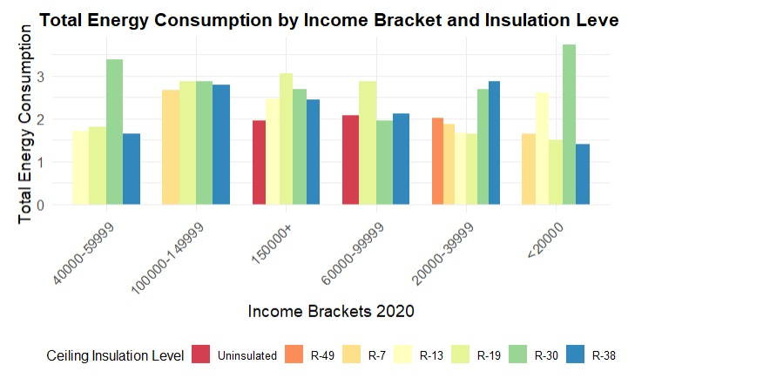
Energy consumption by income level
This bar graph illustrates the energy consumption across various income levels and insulation grades.
Within each income bracket, different insulation levels seem to impact energy consumption. However, the pattern is not uniform across all income levels.

Slide 13
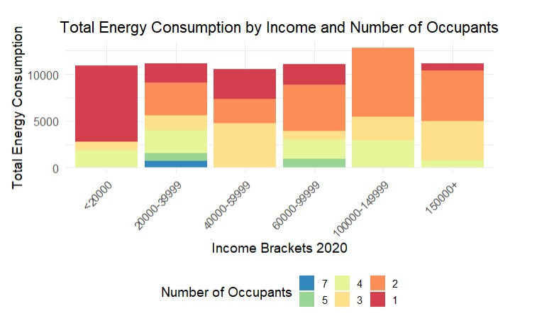
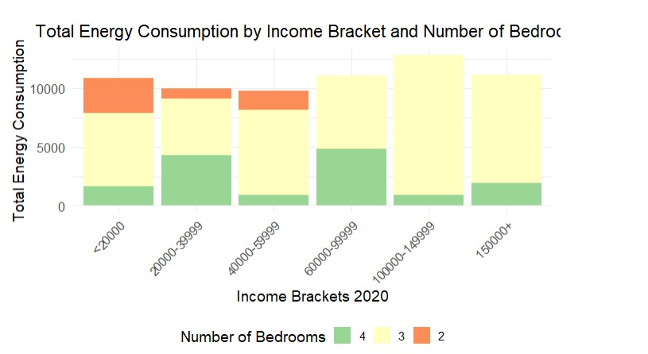
Feature Engineering and Modeling
This bar graph presents energy consumption categorized by diverse income levels and the count of occupants.
This bar graph illustrates energy consumption across varying income levels and the number of bedrooms.

Slide 14
Predicting energy usage if the summer was 5 degrees warmer
Enhanced insulation and a substantial PV system can significantly improve a building's energy efficiency, potentially reducing energy consumption despite rising temperatures.
Occupants may adapt to warmer conditions by adopting more energy-efficient practices, such as using fans instead of air conditioning or adjusting thermostat settings.
Building characteristics, such as the number of bedrooms and occupants, offer insights into energy usage patterns. A well-insulated home with a large PV system and fewer occupants may consume less energy, even with more bedrooms.
The decrease in energy consumption despite warmer temperatures may be attributed to improved building insulation and the contribution of PV systems to energy generation.
Changes in occupant behavior or other energy-saving measures could offset the anticipated increase in energy usage from higher cooling demands, resulting in an overall reduction in net energy consumption.
Notes:
If you switch all the none pv ducts to 1.0kwdc the 5.3 to 4.1
Ducts dcreaece is to a slightly less degree on its ow 5.3 to just 5.2

Slide 15
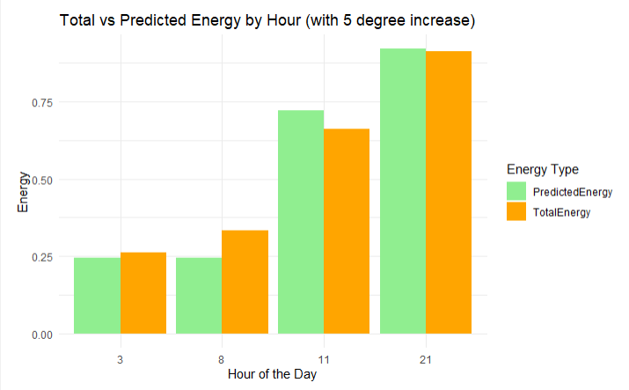
Impact of a 5 Degree Increase in Temperature
The average of energy consumption before temperature increase is 0.6892606 and average after 5-degree increase is 0.6801906
The percentage change of average energy consumption is 1.31% in next July

Slide 16
Provide actionable insight into how to reduce energy consumption
Energy Efficiency Incentives: Offer incentives for installing energy-efficient appliances and retrofitting homes with energy-saving features. These could be tiered based on income to encourage participation across all brackets.
Renewable Energy Solutions: Encourage the installation of renewable energy sources, like solar panels, especially in high-income households that can afford the initial investment.
Awareness Campaigns: Develop educational campaigns targeting higher-income households to raise awareness about the environmental impact of high energy consumption and ways to reduce it.
Tiered Energy Pricing: Implement a progressive energy pricing system where the unit cost of energy increases with higher consumption levels, incentivizing reduced usage.

Slide 17
References
A Comparison of Energy Consumption in American Homes by Climate Region
Performance Evaluation of a Hot-Humid Climate Community

Slide 18
Thank you
Arsh
Swetha
Ruchir
Revanth Vudutha

